Slide 1
ONLINE APPOINMENT APPLICATION

Slide 2
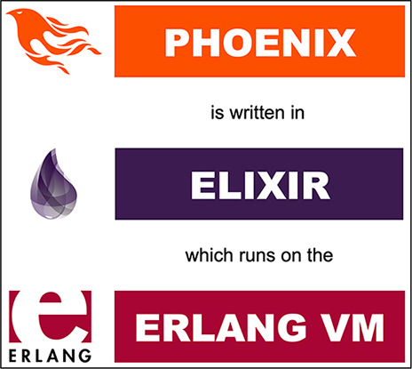
SOFTWARES USED IN THIS PROJECT
Erlang
Elixir
Phoenix Framework

Slide 3
ERLANG / OTP
This chapter covers
■ Understanding concurrency and Erlang’s process model
■ Erlang’s support for fault tolerance and distribution
■ Important properties of the Erlang runtime system
■ What functional programming means, and how it applies to Erlang

Slide 4
What does OTP stand for? OTP was originally an acronym for Open Telecom Platform, a bit of a branding attempt from the time before Erlang went open source. But few people care about that now ,these days, it’s just OTP. Nothing in either Erlang or OTP is specific to telecom applications: a more fitting name might have been Concurrent Systems Platform.

Slide 5
Productivity—Using OTP makes it possible to produce production-quality systems in a very short time. Stability—Code written on top of OTP can focus on the logic and avoid errorprone reimplementations of the typical things that every real-world system needs: process management, servers, state machines, and so on. Supervision—The application structure provided by the framework makes it simple to supervise and control the running systems, both automatically and through graphical user interfaces. Upgradability—The framework provides patterns for handling code upgrades in a systematic way. Reliable code base—The code for the OTP framework is rock solid and has been thoroughly battle tested.

